Slide 1
Order Management Application
Prepared by:
Saqlain Atique
Mentor:
Rahul Vikash
Salesforce Admin and Developer

Slide 2
Abstract
The Order Management System is a Salesforce based application to simplify your sales operations. It features process automation which reduces the workload for the employees. The application helps to track real time stock quantity of the products. The Sales User can create, review and edit the orders. The application allows them to view, edit, confirm or cancel the order before the order is activated. The Approval requests is sent automatically to the Business User for large Orders. Email and In App notifications are configured to automatically notify the related Contacts and Users at each stage of the Order. All the data in the application can be viewed, modified by the Support Team.

Slide 3
Scope
There are three categories of users using the application : Sales User, Business User and Support Team. Each of these would have some exclusive privileges.

Slide 4
Support Team can
Create Business and Sales Users.
Assign users to roles and account teams.
View all the data in the application.
Delete any record.
View Dashboards and Reports for all Orders.

Slide 5
Business Users can
Manage 2 Sales Users.
Manage 10 Accounts.
View all related data for their respective Accounts.
Approve Orders with Amount greater than 100000.
View Dashboards and Reports on Orders for their Accounts.

Slide 6
Sales Users can
Manage 5 Accounts.
Create Orders for those Accounts.
Create Invoice(using Data Loader in this Application).
View Dashboards and Reports on Orders for their Accounts.

Slide 7
Automations
Adding 1 free product if order product quantity is greater than 10.
Stock Quantity auto updates with every Order.
Order automatically gets accepted when Amount is less than 100000.
Order automatically goes for managing Business Users approval when Amount is greater than 100000.
Order Status changes automatically with different inputs.
Email Notification is sent out at each Order status to related Contacts and Users.
In App Notifications for related Users at each Order status.

Slide 8
Order Stages

Slide 9
When the Sales User creates the Order
Invoice created by Sales User using external system.
According to Delivery checkbox in Invoice Object
Created
In Process
Invoice Generated
Payment Received
Delivered
Cancelled
After approval of the Order(automatic or Business User)
According to Payment Received checkbox in Invoice Object
Determined by Sales User

Slide 10
Flow Chart

Slide 11
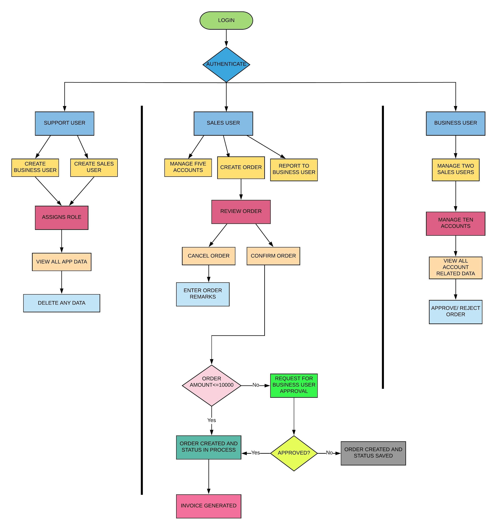

Slide 12
Application Dashboard

Slide 13
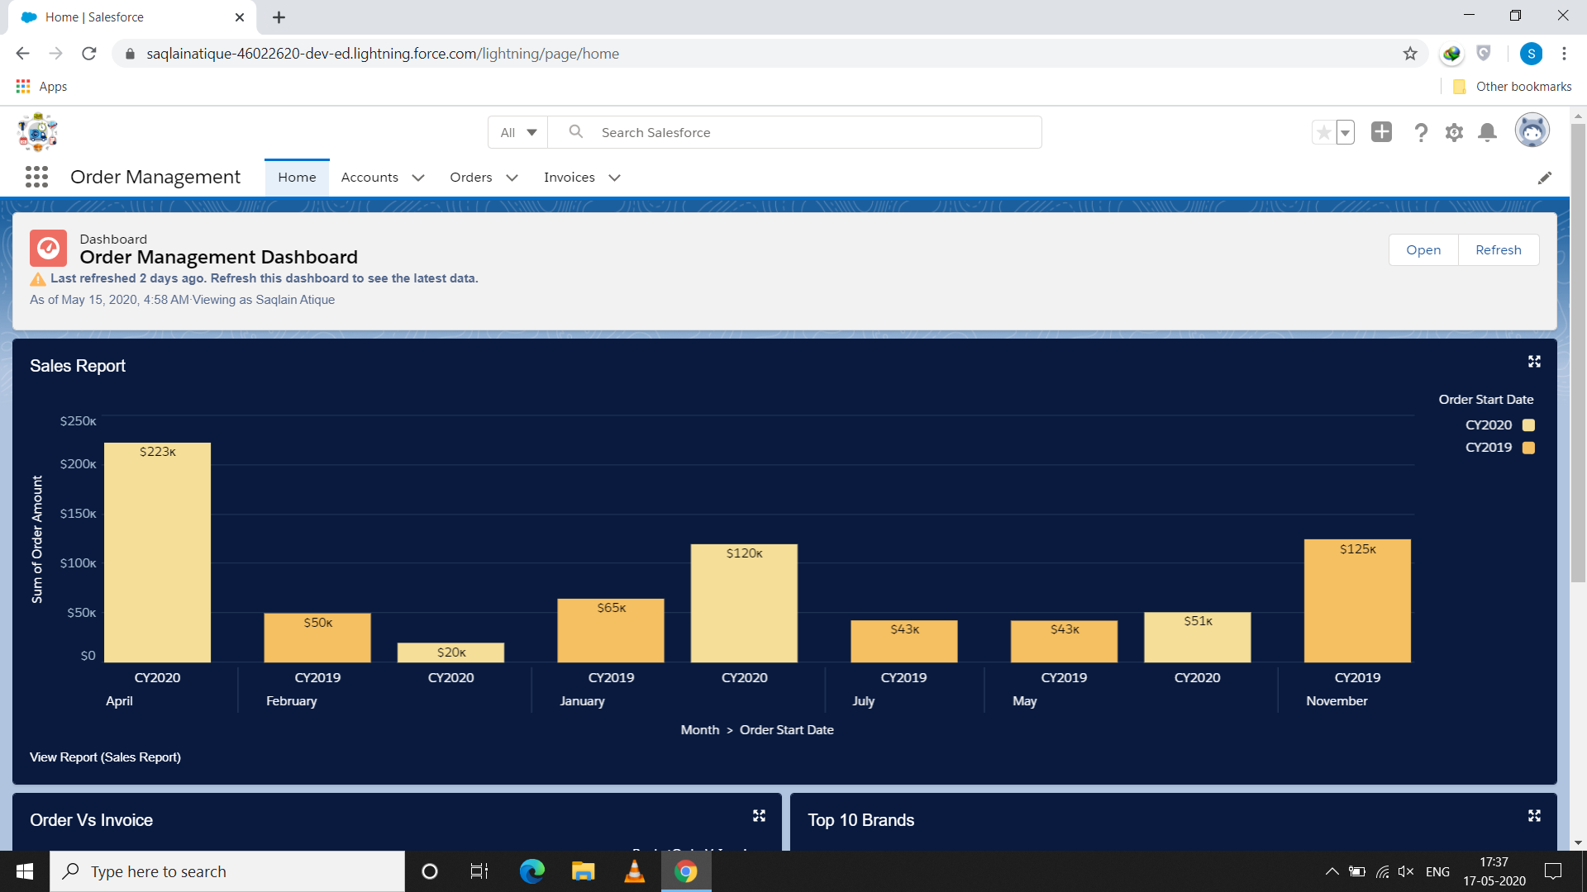

Slide 14
Create or Edit
Order

Slide 15
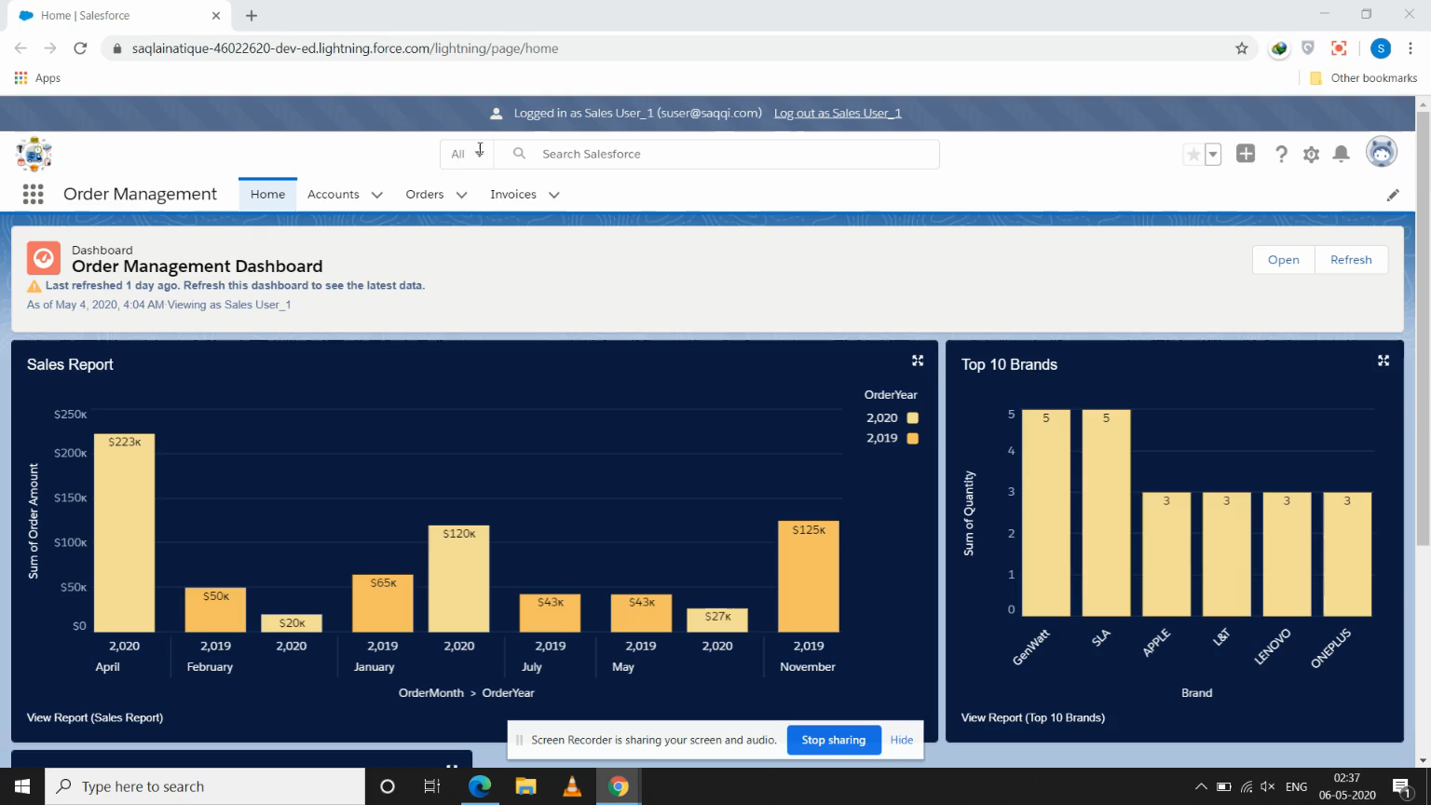
This video shows a Sales User creating an Order.

Slide 16
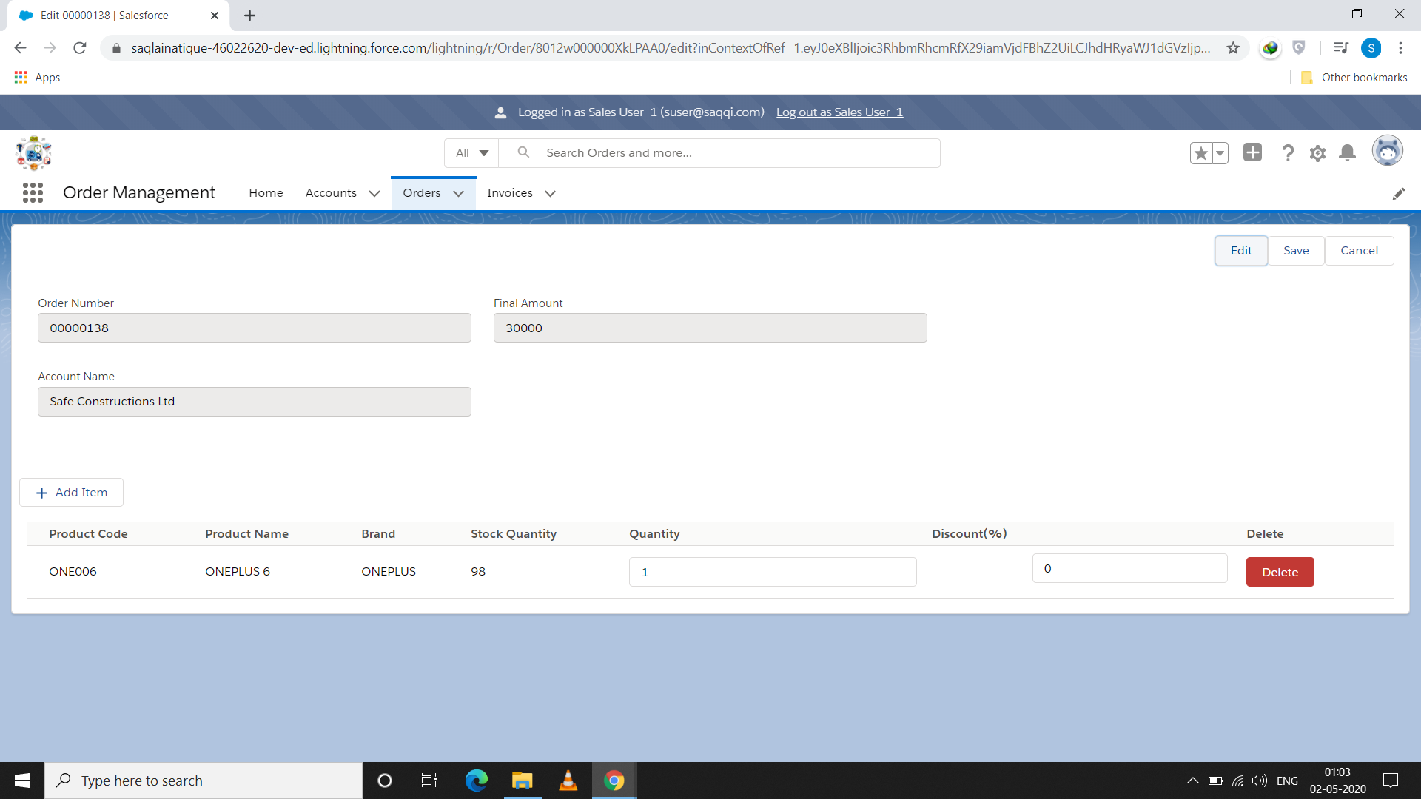
View/Edit Order Screen

Slide 17
Notifications to Contacts and Users

Slide 18
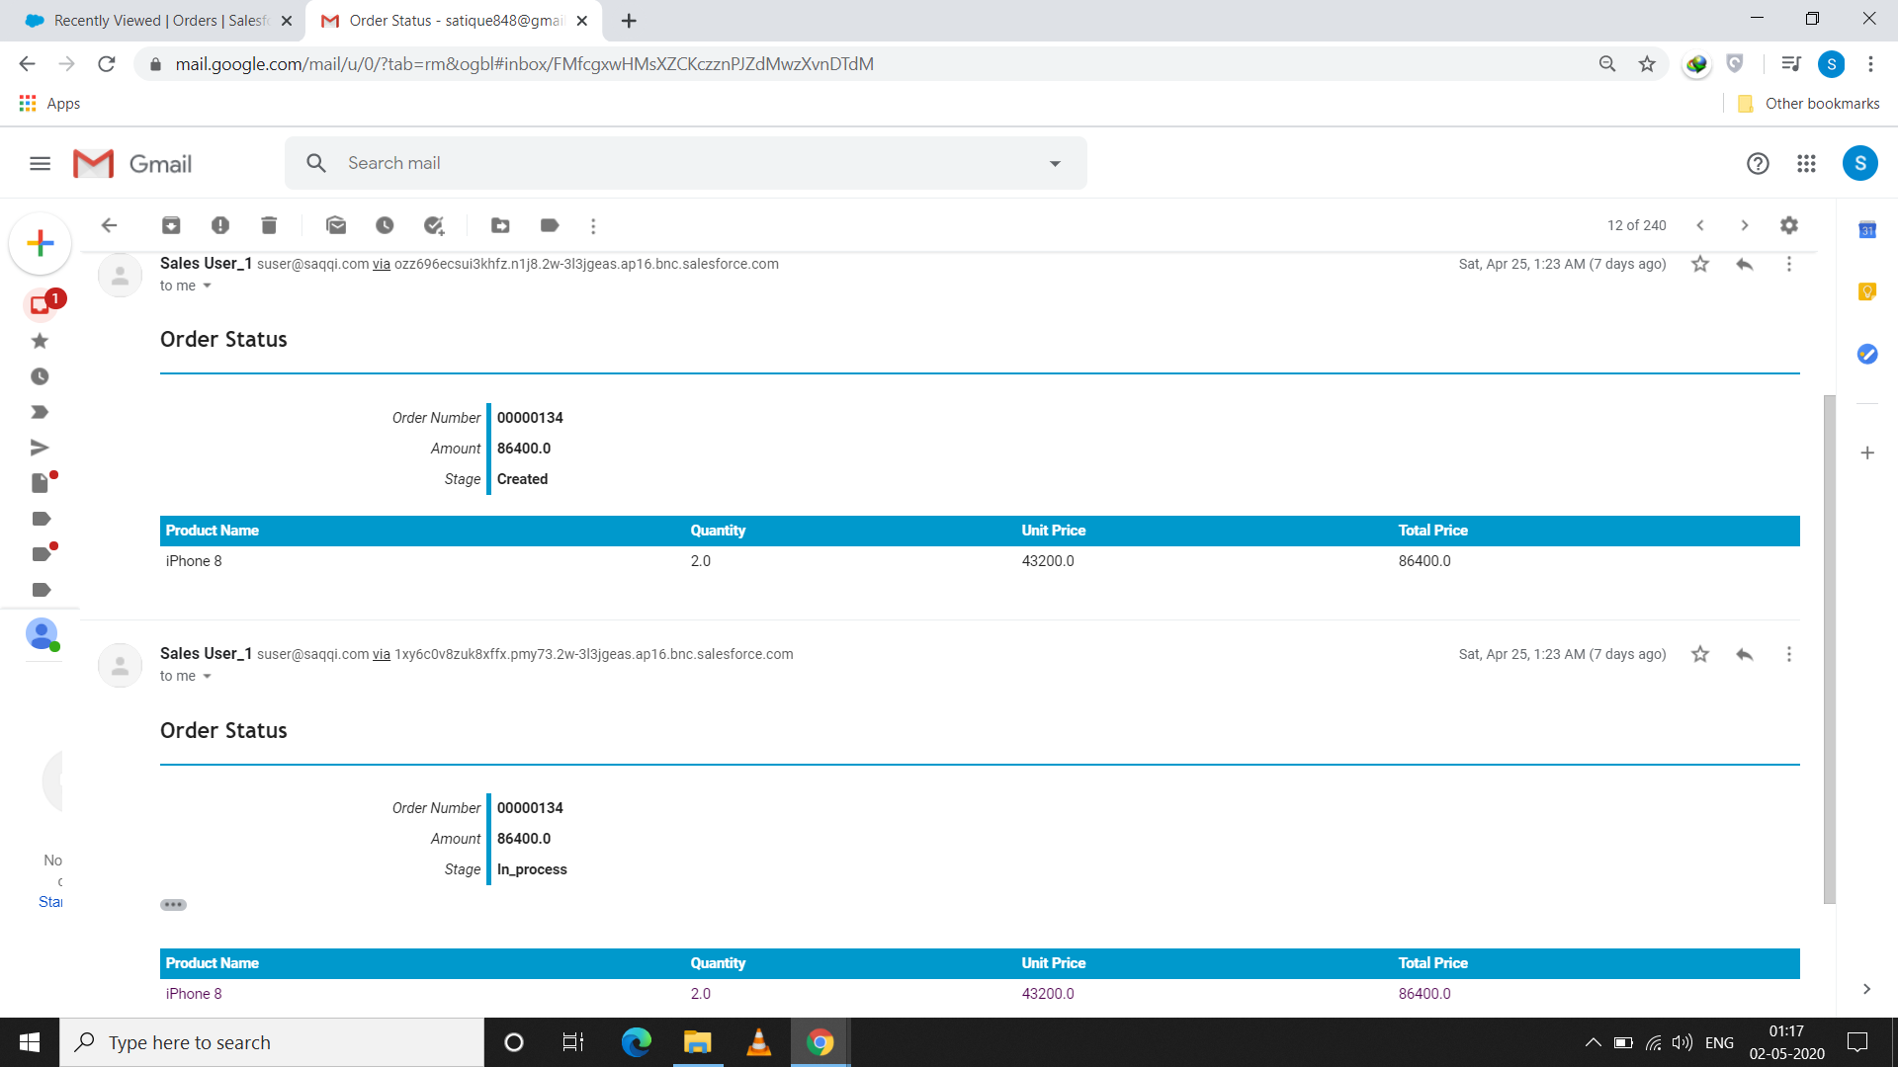
Email Notifications

Slide 19
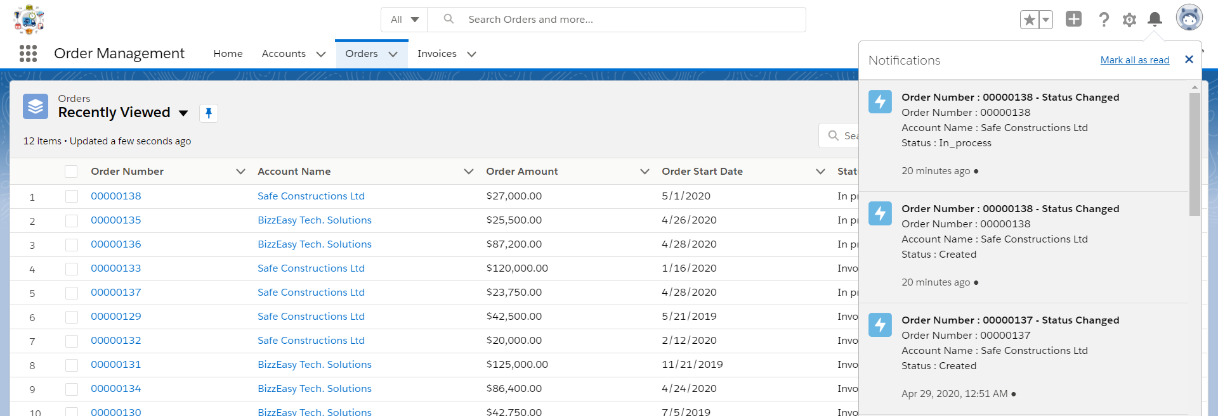
In App Notifications

Slide 20
Validations
Order Status cannot be changed back to previous Status.
One Business user can be manager of at most Two Sales Users.
One Business User can manage Ten accounts.
One Sales User can create orders for Five accounts.
One must enter remarks if the order stage is cancelled.
Orders cannot be placed for products with stock quantity 0.

Slide 21
Thank You

